Slide 1
WELFARE ECONOMICS
SLIDES
BY
KULWIJILA, M.
DEPARTMENT OF ECONOMICS
THE UNIVERSITY OF DODOMA
1

Slide 2
Introduction
Welfare economics is a branch of economics that focuses on the optimal allocation of resources and how the allocation of these resources affect social welfare.
In general equilibrium we have focused on Pareto efficiency in evaluating economic allocations but there are other important considerations which are important such as society’s equity well-being with different resource allocation outcomes.
Hence we need a powerful tool that will incorporate both efficiency and equity and this tool is called welfare function.
2

Slide 3
WELFARE FUNCTION
Welfare function: a way of adding together the utilities of the individual member of a society. More generally, it provides a way to rank different distributions of utility among consumers.
Two ways are used to add together or aggregate consumer’s preferences.
1. Majority Voting: If X is preferred to Y, then we could agree that X is socially preferred to Y since the majority of the individuals/consumers prefer X to Y. One of the problems associated with majority voting is that it may not generate a transitive social preference ordering.
3

Slide 4
WELFARE FUNCTION
Example: Suppose the society decides to use majority voting to decide on which is the most preferred allocations as depicted below:-
Table 1: Preferences that lead to intransitive voting
Each column shows how the voter ranks the choices among the three commodities.
Majority of people in the society prefer X to Y, a majority prefers Y to Z and lastly a majority prefers Z to X.
Choices | Person A | Person B | Person C
1 | X | Y | Z
2 | Y | Z | X
3 | Z | X | Y
4

Slide 5
WELFARE FUNCTION
Thus, aggregating individuals preferences by majority voting won’t work because social preferences resulting from majority voting are not well behaved preferences, since they are not transitive.
Since preferences are not transitive, there will be no best alternative from the set of alternatives (X, Y & Z) i.e. with majority voting social preferences are inconsistent.
They could be transitive if the three people in the table decide to vote first on X versus Y and then vote on the winner of this two versus Z (i.e. if X is preferred to Y, Y to Z, X to Z hence social preferences consistent because transitive rule has met.
5

Slide 6
WELFARE FUNCTION
2. Rank order voting: Here each person ranks the goods according to his preferences and assigns a number that indicates its rank in his ordering e.g 1 can stand for the best alternative, 2 for the second alternative and so on.
The sum of the scores for each alternative is done across the people to determine an aggregate score for each alternative.
The outcome is socially preferred to another if it has a lower score.
6

Slide 7
WELFARE FUNCTION
Example: Consider a preference ordering for three allocations X, Y & Z by two people. If person A gives X a score of 1, Y a score 2 and Z a score of 3 while person B give Y a score of 1, Z a score of 2 and X a score of 3.
Then X have an aggregate rank of 4, Y aggregate rank of 3 and Z aggregate rank of 5. Y is a social preferred good to X and Z because has a lower score.
Person A | A’s Rank score | Person B | B’s rank score
X | 1 | Y | 1
Y | 2 | Z | 2
Z | 3 | X | 3
7

Slide 8
WELFARE FUNCTION
Problems with both majority and rank order voting
The outcome of both methods can be manipulated by a wise/ intelligent person.
For majority voting the outcome can be manipulated by changing the order on which things are voted so as to yield the desired outcome.
Rank order voting can be manipulated by introducing new alternatives that change the final ranks of the relevant alternatives. For example person C would always try to have the structure of voting that would achieve Z as the outcome.
8

Slide 9
Properties of a social decision mechanism
A reasonable social ranking may be stated with the following axioms relating individual consumers’ preferences
Axiom 1: Completeness—Social ranking must rank all social states
Either A > B, B > A, or A ∼ B for any two states
Identical to Completeness Axiom for individual preference ordering
Axiom 2: Transitivity—Society’s social ranking must be transitive
Given three social states, A, B, and C, if A > B and B > C, then A > C
Identical to Transitivity Axiom for individual preference ordering
Axiom 3: Pareto—If every consumer prefers A to B, then A is preferable in a social ranking
This also holds for the other two pairs (A, C) and (B, C)
Identical to a Pareto improvement
Axiom 4: Nondictatorial—One consumer’s preferences should not determine society’s preferences
No agent paternalism
Axiom 5: Pairwise Independence—Society’s social ranking between A and B should depend only on individual preferences between A and B
Not on individual preferences for some other social state, say state C
Identical to Independence Axiom for individual preference ordering of states of nature
9

Slide 10
Arrow’s Impossibility Theorem
Can now state Arrow’s Impossibility Theorem more formally
Impossible to establish a reasonable social preference ranking based solely on individual preference rankings.
A social decision mechanism satisfying the above five axioms is impossible, if any then it is a dictatorship.
Implies that there is no perfect way to aggregate agents’ preferences to make one social preference because not everybody have preferences in the same direction.
If we want to find a way to aggregate individuals preferences to form social preferences, we must give up (violate) one of the properties of a social decision mechanism or one of the above axioms.
Thus, social choice must be unreasonable if it is based on agents’ preference ranking
10

Slide 11
Arrow’s Impossibility Theorem
To see that Arrow’s Impossibility Theorem holds, let’s consider majority voting again
Important social preference mechanism design
Set of rules governing procedures for social [collective] choice
Majority voting satisfies both Pareto Axiom and Non-dictatorial Axiom
Sensitive to each individual agent’s preferences
Majority voting is symmetric among agents
Treats all agents the same and all agents have just one vote
It is also neutral among alternatives
By not making a distinction among alternatives a priori
However, majority rule can lead to a pattern of social choices that is not transitive
Thus, it violates Axiom 2
11

Slide 12
Social-Welfare Function (SWF)
Using broad definition of social welfare as a level of happiness for society as a whole
Measurement for this happiness is needed to determine socially optimal allocation of resources
Such a measurement for determining how well off agents are in a society requires a set of welfare criteria
Much of research on formulation of welfare criteria and their implications for economic policy has relied on Pareto-allocation criterion
A Pareto criterion is a value judgment based on unanimity rule
If one agent could be made better off without reducing welfare of others
Social welfare could be improved by allocation that makes this one agent better off
Since no one agent is made worse off and at least one agent is made better off
It is assumed, given independence of utility functions, that all agents would support Pareto criterion
12

Slide 13
Social-Welfare Function
Pareto-optimal allocation yields an efficient allocation of resources and thus is a necessary condition for a social optimum
However, many decisions on allocation result in an improvement of one agent’s utility at expense of other agents
For example, a redistribution of endowments from taxing rich households and providing subsidized housing for poor households may increase social welfare
But cannot be justified by Pareto criterion
Fundamental inadequacy of Pareto criterion is its inability to yield a complete ranking of all social states within an economy
Pareto criterion is useless in context of many policy propositions, so additional welfare criteria are necessary to determine if these policies will improve social welfare
To investigate a social-welfare function, a comparison of individual consumers’ utilities is generally required. More precisely, SWF is a function of the utility levels of all individual members in the society
It gives a way to rank different allocations that depends only on the individual preferences and it is an increasing function of each individual’s utility.
It is denoted as W {U1(X),…….,Un (X)}. W = social welfare & U= individual utilities
13

Slide 14
Example of Social welfare function
Utilitarian welfare functions.
Weighted sum of utilities welfare functions.
Minimax or Rawlsian social welfare functions
14

Slide 15

Utilitarian
Individual utility functions are summed up or Maximizes sum of consumers’ utility. Mathematically it is represented as W (U1, ….., Un) =
Criterion was formally developed by Bentham and provided initial impetus to utility theory
For Robinson and Friday, criterion is
Called classical utilitarian, or Benthamite welfare function
Maximized subject to a utility possibilities frontier (Figure 1)
Under utilitarian criterion, increases or decreases in individual consumers’ utility results in identical changes in social welfare
Only total utility is relevant, so utilitarian criterion does not consider distribution of utility
As long as social gain is greater than social loss, it makes no difference that consumer who gains in utility may already be happier than the other consumer
Unless utility functions of individual consumers are close to being identical
Utilitarian criteria can result in substantial differences in consumers’ utility
Although ethics teaches that virtue is its own reward, classical utilitarian function teaches that reward is its own virtue
Only total level of utility is important
15

Slide 16
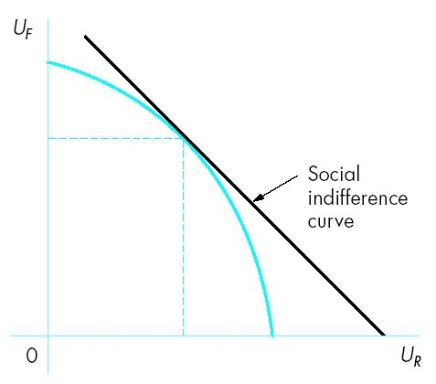
Figure 1: Benthamite (classical utilitarian) social welfare function
16

Slide 17
Weighted sum utilities
A slight generalization of classical utilitarian function, we get a generalization of the weighted sum of utilities welfare function
Weighted sum of utilities is represented as
Weights (α_{R}, α_{F}) are numbers which indicate how important each consumer’s utility is to overall social welfare
In Figure 1, utilitarian social welfare optimal allocation is tangency between social indifference curve and utility possibilities curve
Depending on weights associated with individual consumers’ utility
Any Pareto-efficient point on utility possibilities frontier could be a social-welfare maximum
The more egalitarian a society is, the more its social indifference curves will approach right angles
Indicating society is concerned with equity issues of distribution
For a utilitarian society that is indifferent to distribution, curves are more linear
Showing society simply maximizes output
17

Slide 18

Minimax or Rawlsian social welfare function
A social-welfare function resulting in equality of utilities is Rawlsian
For Robinson and Friday, this criterion sets U_{R} = U_{F}
Most equitable allocation maximizes utility of least-well-off consumer in society that is persons with the minimal utility.
Rawlsian says that social welfare can not increase unless the income of the poorest individual in the society is increased.
It is denoted as W (U1,…,Un) = min {U1, …., Un}
For Robinson and Friday, Rawlsian criterion is
Maximum level of social welfare given a specific utility possibilities frontier is on Pareto-efficient utility possibilities frontier (Figure 2)
Unless Robinson and Friday have the same utility functions
Equality of utilities will not result in Robinson and Friday each receiving the same commodity allocation
18

Slide 19
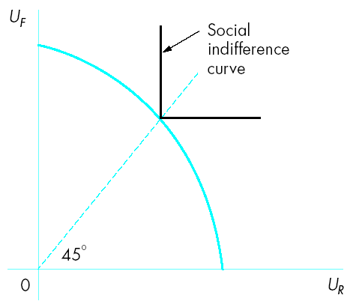
Figure 2: Rawlsian social-welfare function
19

Slide 20
Welfare maximization
We maximize welfare function subject to a utility possibilities frontier based on individual consumers’ preferences.
The logic behind welfare maximization is to find ways of attaining equitable allocation that maximizes welfare.
Consider pure-exchange economy we discussed in GE i.e., 2-consumer (Friday and Robinson), 2-commodity (q₁ and q₂)
Only points on contract curve can be considered as possible candidates for a social optimum. For example, points P₁, P₂, and P₃ represent tangencies of Friday’s and Robinson’s indifference curves
Any point off this contract curve is not Pareto efficient because it is possible to increase welfare of one consumer without reducing welfare of the other
From contract curve, we can derive a utility possibilities frontier
Theoretically similar in construction to production possibilities frontier
20

Slide 21
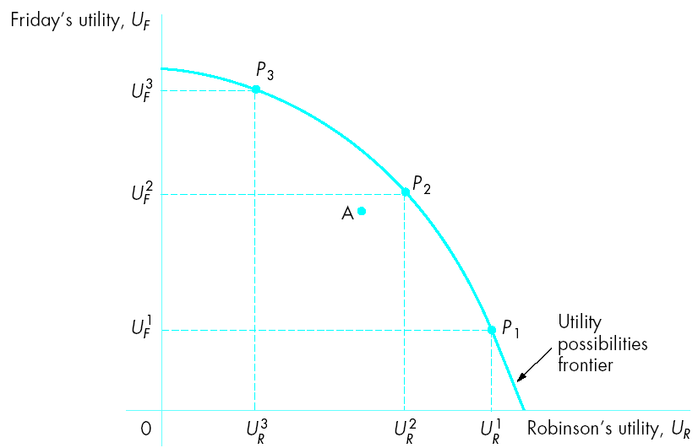
Figure 3: Utility possibilities frontier
21

Slide 22
Maximizing Social Welfare
Efforts by governments to achieve a more equitable allocation are costly in terms of possibly generating inefficiencies within an economy
Can use concept of a social-welfare function as method for determining socially optimal allocation among points on a utility possibilities frontier
With a social-welfare function, can determine point that maximizes social welfare in terms of both equity and efficiency criteria subject to utility possibilities frontier
22

Slide 23

Maximizing Social Welfare
For example, consider following social-welfare function, U, for an economy consisting of two consumers (Robinson, R, and Friday, F)
Assuming a diminishing marginal rate of substitution between consumer utilities, we can determine convex social indifference, or isowelfare, curves
Assumption implies that society has inequality aversion
Where (holding social welfare constant) the more satisfaction Robinson has the less society is willing to give up Friday’s utility for one more unit of Robinson’s utility
The tangency between a social indifference curve and utility possibilities frontier results in maximum level of social welfare
Point P₂ is only point on utility possibilities frontier where there is no other point preferred to it
For example, point P₃ is Pareto efficient but there are points that are preferred to P₃
Even though point A is Pareto inefficient, society prefers it over Pareto-efficient point P₃
Using maximum level of social welfare, point P₂, we determine optimal allocation of commodities in Edgeworth box for a pure-exchange economy
Or in production possibilities frontier for a production economy
23

Slide 24
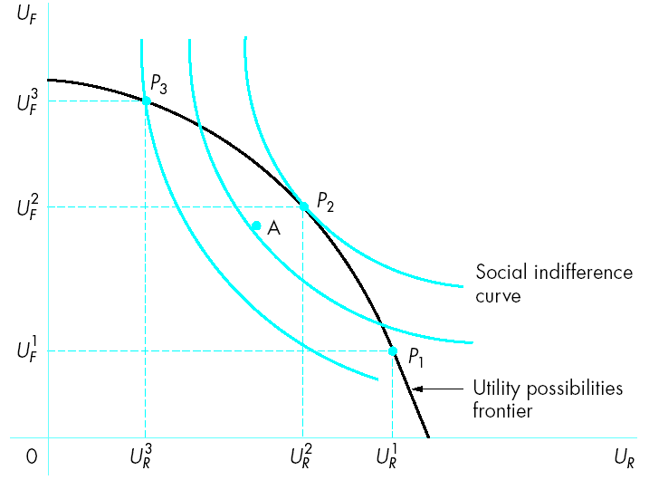
Figure 4 Maximizing social welfare
24

Slide 25
Welfare maximization
Isowelfare curves: Shows combination of utilities which give the same social welfare to the society.
What observations do we pick from the figure?
1. A maximal welfare allocation must be Pareto efficient allocation (1st theorem of welfare)
2. Any Pareto efficient allocation must be a welfare maximization for some welfare function (2nd theorem of welfare)
25

Slide 26
Fair and Envy Allocation
An allocation is fair if the goods available are divided equally among agents/individuals(equal division). A fair allocation is symmetrical in the sense that each agent has the same bundle of goods, no agent prefers any other agents bundle of goods to his/her own since they all have exactly the same thing.
On the other hand if some agents say i prefers some other agents j’s bundle of goods, we say that i envies j. That is i and j have different bundle of goods.
26

